Slide 1
Course Title
Operating Systems
Course No.
CSE - 3103
Instructor
Miss. Rokeya Akter
Lecturer & Prog. Coordinator
Khwaja Yunus Ali University

Slide 2
Critical Section Problem and How to address it
1. Process synchronization techniques play a key role in maintaining the consistency of shared data
2. Critical Section (C.S)
a. The critical section refers to the segment of code where processes/threads access shared resources, such as common variables and files, and perform write operations on them. Since processes/threads execute concurrently, any process can be interrupted mid-execution.

Slide 3
Major Thread scheduling issue
Race Condition
A race condition occurs when two or more threads can access shared data and they try to change it at the same time. Because the thread scheduling algorithm can swap between threads at any time, you don't know the order in which the threads will attempt to access the shared data. Therefore, the result of the change in data is dependent on the thread scheduling algorithm, i.e., both threads are "racing" to access/change the data.

Slide 4
Solution to Race Condition
Atomic operations: Make Critical code section an atomic operation, i.e., Executed in one CPU cycle.
Mutual Exclusion using locks.
Semaphores

Slide 5
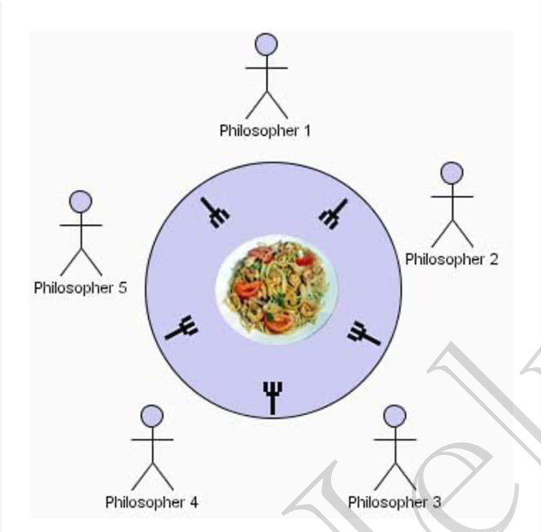
The Dining Philosophers problem

Slide 6
The Dining Philosophers problem
We have 5 philosophers.
They spend their life just being in two states: a. Thinking b. Eating
They sit on a circular table surrounded by 5 chairs (1 each), in the center of table is a bowl of noodles, and the table is laid with 5 single forks.
Thinking state: When a ph. Thinks, he doesn’t interact with others.
Eating state: When a ph. Gets hungry, he tries to pick up the 2 forks adjacent to him (Left and Right). He can pick one fork at a time.
One can’t pick up a fork if it is already taken.
When ph. Has both forks at the same time, he eats without releasing forks.

Slide 7
The Dining Philosophers problem
8. Although the semaphore solution makes sure that no two neighbors are eating simultaneously but it could still create Deadlock.
10. Suppose that all 5 ph. Become hungry at the same time and each picks up their left fork, then All fork semaphores would be 0.
11. When each ph. Tries to grab his right fork, he will be waiting for ever (Deadlock)

Slide 8
The Dining Philosophers problem
12. We must use some methods to avoid Deadlock and make the solution work.
a. Allow at most 4 ph. to be sitting simultaneously.
b. Allow a ph. to pick up his fork only if both forks are available and to do this, he must pick them up in a critical section (atomically).

Slide 9
The Dining Philosophers problem
c. Odd-even rule. an odd ph. Picks up first his left fork and then his right fork, whereas an even ph. Picks up his right fork then his left fork.
13. Hence, only semaphores are not enough to solve this problem. We must add some enhancement rules to make deadlock free solution.

Slide 10
Operating Systems & Systems Programming
Deadlock
Deadlock can be defined formally as follows:
A set of processes is deadlocked if each process in the set is waiting for an event that only another process in the set can cause.

Slide 11
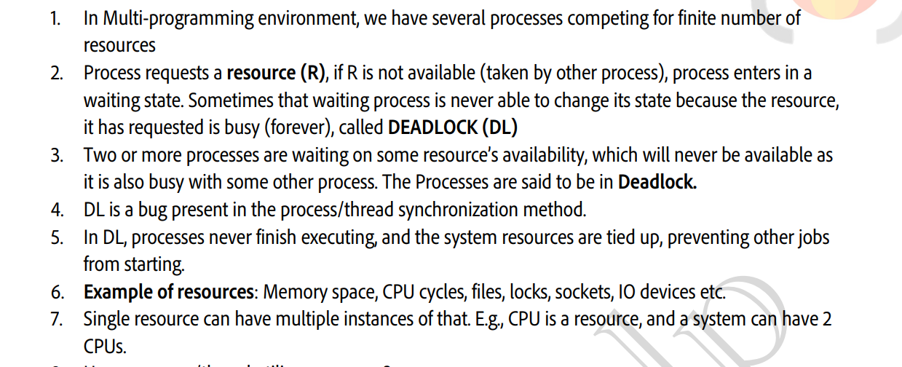
Deadlock Part-1

Slide 12
How a process/thread utilize a resource?
Request: Request the R, if R is free Lock it, else wait till it is available.
Use
Release: Release resource instance and make it available for other processes

Slide 13
Operating Systems & Systems Programming
Deadlock
Conditions for Resource Deadlocks
Coffman et al. (1971) showed that four conditions must hold for there to be a (resource) deadlock.
Deadlock Necessary Condition: 4 Condition should hold simultaneously.
Mutual Exclusion
Only 1 process at a time can use the resource, if another process requests that resource, the requesting process must wait until the resource has been released.
Hold & Wait
A process must be holding at least one resource & waiting to acquire additional resources that are currently being held by other processes.

Slide 14
Deadlock Necessary Condition
c. No-preemption
Resource must be voluntarily released by the process after completion of execution. (No resource preemption)
d. Circular wait
A set {P0, P1, … ,Pn} of waiting processes must exist such that P0 is waiting for a resource held by P1, P1 is waiting for a resource held by P2, and so on.

Slide 15
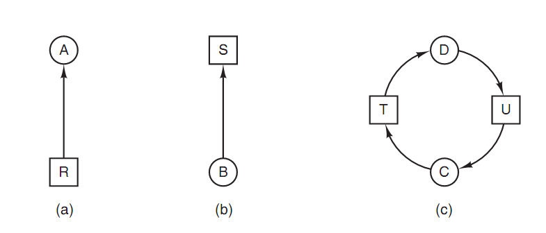
Operating Systems & Systems Programming
Deadlock
Deadlock Modeling
The sequence of events required to use a resource is given below.
1. Request the resource. 2. Use the resource. 3. Release the resource.
Figure . Resource allocation graphs. (a) Holding a resource. (b) Requesting
a resource. (c) Deadlock.

Slide 16
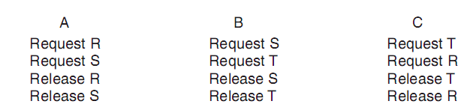
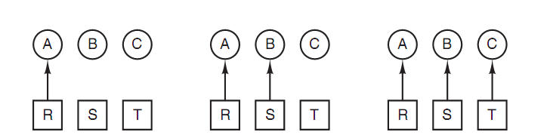
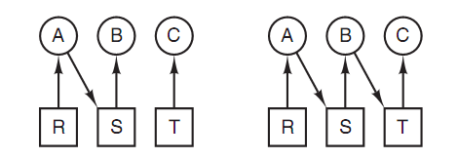
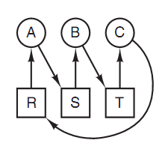
Operating Systems & Systems Programming
Deadlock : how deadlock occurs
A holding R B holding S C holding T
A requests S B requests T C requests R
deadlock

Slide 17
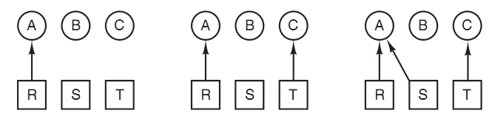
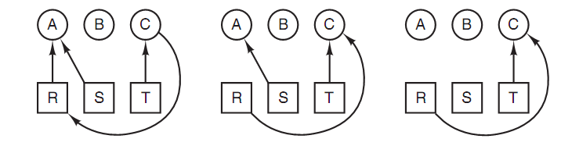
Operating Systems & Systems Programming
Deadlock : how deadlock can be avoided
A holding R C holding T A holding S
C requests R A releases R A releases S

Slide 18
Operating Systems & Systems Programming
Methods for handling Deadlocks
In general, four strategies are used for dealing with deadlocks or handle the deadlocks.
Just ignore the problem. Maybe if you ignore it, it will ignore you.
Detection and recovery. Let them occur, detect them, and take action.
Dynamic avoidance by careful resource allocation.
Prevention, by structurally negating one of the four conditions.

Slide 19
Operating Systems & Systems Programming
Deadlock
Deadlock Detection with One Resource of Each Type
Example
1. Process A holds R and wants S.
2. Process B holds nothing but wants T.
3. Process C holds nothing but wants S.
4. Process D holds U and wants S and T.
5. Process E holds T and wants V.
6. Process F holds W and wants S.
7. Process G holds V and wants U.
The question is: "Is this system deadlocked, and if so, which processes are involved?"

Slide 20
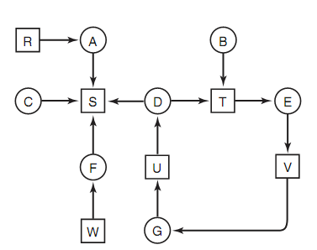
Operating Systems & Systems Programming
Deadlock
To answer this question, we can construct the resource graph as of Figure below:

Slide 21
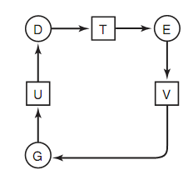
Operating Systems & Systems Programming
Deadlock
This graph contains one cycle, which can be seen by visual inspection. The cycle is shown in Figure below:

Slide 22
Operating Systems & Systems Programming
Deadlock
From this cycle, we can see that processes D, E, and G are all deadlocked. Processes A, C, and F are not deadlock because S can be allocated to any one of them, which then finishes and returns it. Then the other two can take it in turn and also complete.

Slide 23
Thank you
It doesn’t matter what others are doing, it matters what you are doing.

